Slide 1


Online Payment Fraud Detection
Submitted by:
Charmy Patel
Christina Jose
Dhara Panchal
Vishva Shah
Yash Patel
Yuvrajsinh Gohil
Date:: 6th August 2024

Slide 2
Agenda
1.
2.
3.
4.
Introduction
Description &
Objectives
Importance to
the Industry
Data used, cleaning
& pre-processing
5.
6.
7.
8.
Conclusion
Data Science
Algorithms
Data Visualization
Results & Discussion

Slide 3

Introduction
Online payment fraud is a growing challenge in digital finance. Traditional methods are inadequate against modern fraud schemes. This project explores machine learning techniques to enhance fraud detection using a Kaggle dataset. We evaluate various models, from logistic regression to neural networks, to identify fraud patterns and assess performance in accuracy and efficiency. Our approach highlights the importance of advanced analytics in fraud detection and suggests integrating these technologies into real-time prevention systems to reduce risks in online transactions.
Why is it Improtant:
Financial Impact
Trust & Security
Technological Advancements
Industry Relevance

Slide 4


Project Description
•Historical online payment transactions
•Contains 284,807 transactions
•Includes both legitimate and fraudulent transactions
Key Features Used for Analysis:
•Time: The time elapsed between the first transaction and the current transaction in the dataset.
•Amount: The monetary value of the transaction.
•Class: Indicates whether the transaction is legitimate (0) or fraudulent (1).

Slide 5
Project Objective
The primary objective of this project is to enhance the detection and prevention of online payment fraud using advanced machine learning techniques. By identifying patterns indicative of fraudulent transactions, the project evaluates various predictive models, including logistic regression and neural networks, based on their accuracy, precision, recall, computational efficiency, and practical applicability. Rigorous data preprocessing, feature engineering, and model training aim to develop robust fraud detection mechanisms. The ultimate goal is to integrate these advanced analytics into real-time fraud prevention systems, ensuring safer transaction environments globally.

Slide 6
Importance to the Industry:
Growth Threat of fraud
Enhancing Security Measures
Reducing Financial Losses
Building Consumer Trust
Regulatory Compliance
Future Proofing

Slide 7
Dataset:
The dataset comprises historical online payment transactions, offering detailed information on past activities. It includes various transaction types, such as transfers and payments, along with the monetary value of each transaction.
It provides balance information for both the sender and recipient, including the old balance before the transaction and the new balance after the transaction.
This comprehensive data is essential for developing and evaluating models aimed at detecting fraudulent activities.
We have only used the primary dataset that was provided to us.

Slide 8
Data Cleaning & Pre-processing
Handling Missing Values
Feature Engineering
Data Normalization
Encoding Categorical variables
Data Splitting
Handling Class Imbalance

Slide 9
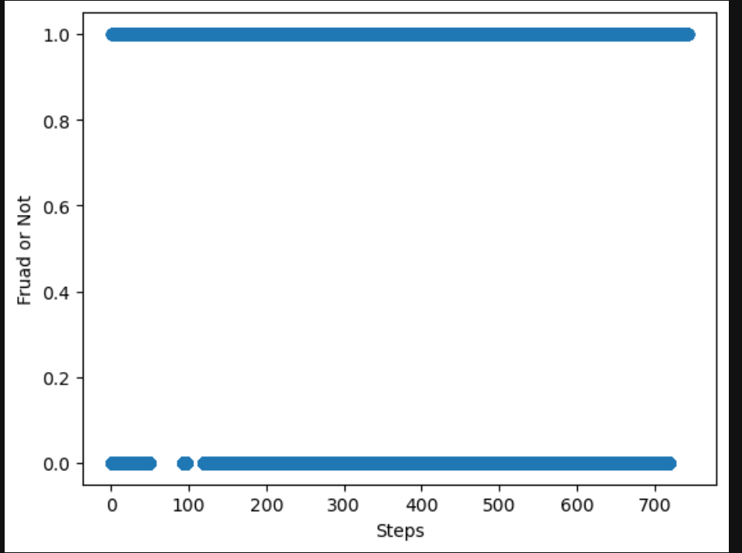
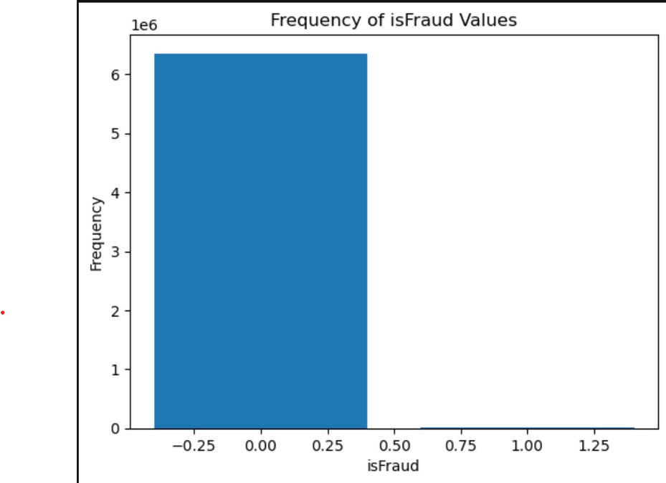
Data Visualization

Slide 10
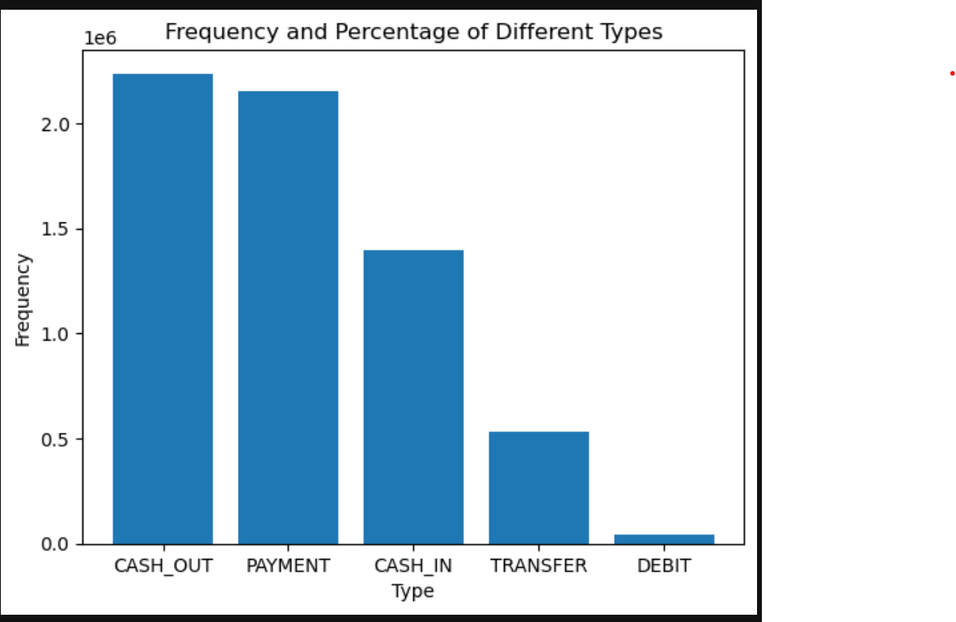
Data Visualization

Slide 11
Data Science Algorithms
Logistic Regression
Random Forest
Artificial Neural Network
why we chose these algorthims?
There are many algorithms for classification problems. These algorithms work well on straightforward datasets and very complex datasets.
Easy to interpret.

Slide 12
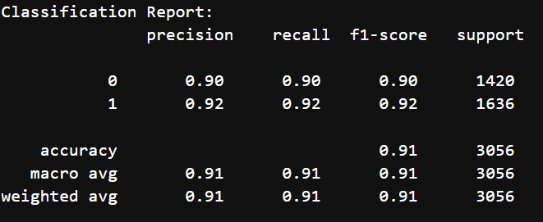
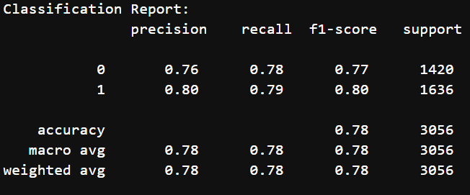
Results and Discussion:
Logistics Regression: 78.44%
Artificial Neural Network: 85.33%
DecisionTree: 91.03%
DT
LR

Slide 13
Conclusion
Implemented and compared ML models (logistic regression, random forest, neural networks) for online payment fraud detection. Random Forest and neural networks excelled in accuracy and F1 score and precision, highlighting their practical application potential.
Enhances security and reliability of online payments, reducing fraud. Financial institutions can leverage these models for robust, proactive fraud prevention strategies.
Future Research Directions:
Real-Time Fraud Detection
Integration with Blockchain Technology
Adaptive Learning System

Slide 14
Thank you

